Slide 1




Overall Project Strategy – Where we stand
Team
Project
Progress
Approach
Lessons
Roadmap
1st Semester
2nd Semester
3rd Semester
4th Semester
Sep -11 | Oct -11 | Nov-11 | Dec -11 | Jan -12 | Feb -12 | Mar -12 | Apr -12 | May -12 | Jun -12 | Jul -12 | Aug -12 | Sep -12 | Oct -12 | Nov -12 | Dec -12
Identify, define, refine architectural drivers in iterative manner
Implementation, integration & testing
Kickoff
Sep 23
ADS
Baselined
SOW
Ref Impl.
Protocols Selected
Transition
Postmortem
Create, refine, and finalize architecture through experimentations
ADD, White Paper
ArchitectureBaselined
Notes:
What did we do to get to these goals?
© 2006 Carnegie Mellon University
Presentation Title

Slide 2
Approach
Team
Project
Progress
Approach
Lessons
Roadmap
Problem / Operations / Planning / Risk
  Problem Definition
  Process and Operations
  Planning and Tracking
  Risks
Notes:
© 2006 Carnegie Mellon University
Presentation Title

Slide 3
Change in Planning Process
Team
Project
Progress
Approach
Lessons
Roadmap
Problem / Operations / Planning / Risk
  We shifted from detailed planning to agile planning.
    Estimation and tracking of work packages as compared to tasks. Several tasks are combined to form a work package.
  Reasons for change in approach
    Overhead activities were increasing
    Updating and maintaining excel sheets was cumbersome.
    Lengthy planning and iteration meetings.
  Pros
    Time bound planning and iteration meetings
    Significant reduction in number of overhead activities
    Given the nature of our project, it is easier to plan with shorter iterations.
    Constant communication and co-ordination among team members
Notes:
© 2006 Carnegie Mellon University
Presentation Title

Slide 4

Agile Planning Strategy & Tactics
Team
Project
Progress
Approach
Lessons
Roadmap
Problem / Operations / Planning / Risk
WBS
Activities
Deliverables
Master Design Plan
Milestones
Overall Strategy
Iteration Planning
Tracking & Control
Work packages with exit criteria and tasks
Estimation of work packages done in velocity points using planning poker.
Work package owners track work packages, who are in turn tracked by the managing engineer.
Post Iteration
Notes:
So this graphic presents an overall view of how we do planning, estimation, and tracking. EXPLAIN the graphic and the flow of information.
© 2006 Carnegie Mellon University
Presentation Title

Slide 5
Risk Process
Team
Project
Progress
Approach
Lessons
Roadmap
Problem / Operations / Planning / Risk
  Last semester, we did not have any risk management process. This semester, we have a well-defined risk management process.
  Time boxed mini Software Risk Evaluation(SRE) session.
  “Threshold of success” of the team is used as a basis for risk identification, evaluation, and prioritization.
  Taxonomy based risk identification questionnaire.
  Evaluation of risks based on impact, probability, and timeframe.
  Prioritization of risks based on a voting process.
  Mitigation plans defined for the high priority risks.
  Weekly risk assessment.
Notes:
Need to discuss these as a team
© 2006 Carnegie Mellon University
Presentation Title

Slide 6
Roadmap
Team
Project
Progress
Approach
Lessons
Roadmap
Notes:
We will now talk about our approach for defining the problem and eliciting requirements
© 2006 Carnegie Mellon University
Presentation Title

Slide 7
Spring 2012 Roadmap
Team
Project
Progress
Approach
Lessons
Roadmap
January
February
March
April
May
1 | 2 | 3 | 4 | 5 | 6 | 7 | 8 | 9 | 10 | 11 | 12 | 13 | 14 | 15 | 16
QAW
Final
Decision
Finalize Protocols
Production
Decision
Production
Decision
ADS
Baselined
EOSP
MOSP
ACDM Stages 1-2
Cycle ACDM Stages 3-6
Notes:
Presentation Title

Slide 8
Time Distribution
    <TODO: See data from Toggl create a graph>

Slide 9
Questions and Feedback
Notes:
Presentation Title

Slide 10
Backup
Notes:
Presentation Title

Slide 11
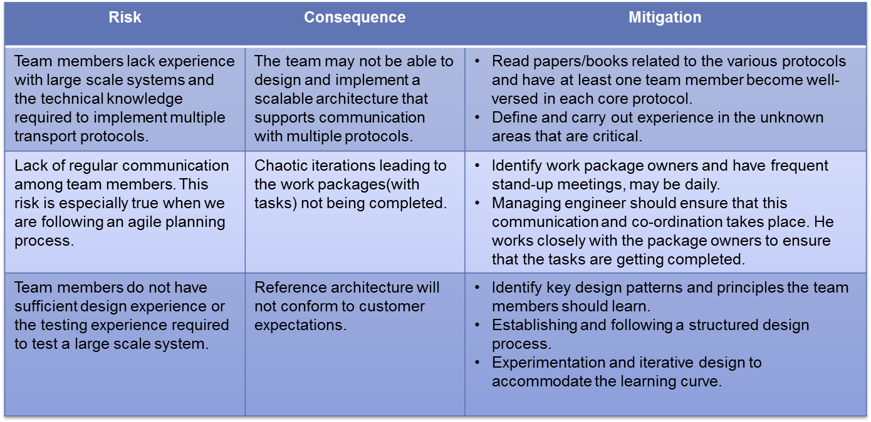
Top 3 Risks (with mitigation plans)
Team
Project
Progress
Approach
Lessons
Roadmap
Problem / Operations / Planning / Risk
Notes:
Need to discuss these as a team
© 2006 Carnegie Mellon University
Presentation Title

Slide 12
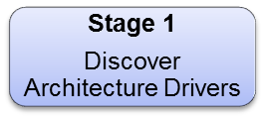
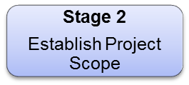
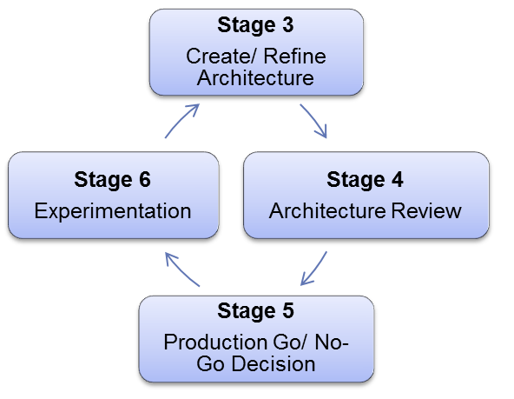
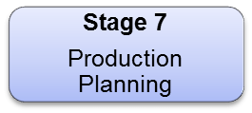
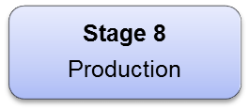
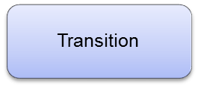
Project Roadmap
Team
Project
Progress
Approach
Lessons
Roadmap
1st Semester
2nd Semester
3rd Semester
4th Semester
Notes:
Presentation Title

